Slide 1
Germany: Achieving 100% Renewables By 2050 ISES 18 th March 2014 Selangor Malaysia
Hans-Josef Fell
President Energy Watch Group
Former Member of German Parliament

Slide 2
Political challenges
Climate warming, loss of biodiversity
peak oil, energy security
nuclear and environmental desasters
oil wars, poverty, economic crises
All these challenges are connected with fossil and nuclear Energies
Renewables will solve these problems

Slide 3
100% Electricity from Renewables
Target by the Green Parliamentarian Group in the Bundestag and many NGOs
TWh
Source: Green Energy Concept, 2010

Slide 4
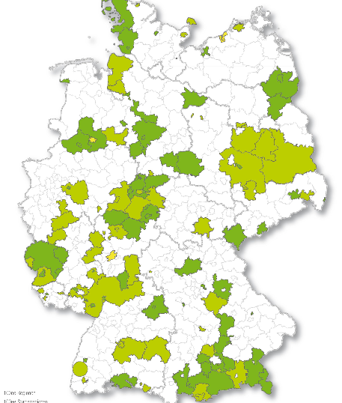
100% RE is already reality today
Countries with a 100% RE target
Denmark; Costa Rica; Island; Scotland; Upper Austria
Cities with 100% RE target
Barcelona, Spain; Masdar City UAE; Munich, Germany; Msheireb Downtown Doha, Qatar; San Francisco, USA
Small Island States with 100% RE target
Islands of Tuvalu; Maledives; Cook Islands
Germany
Notes:
We're 15 to 20 years behind in how we think about renewables.

Slide 5
Civic cooperativs increase in Germany
In the last three years the amount of cooperatives quadriplucated in Germany
Source: Klaus Novy Institute, 2012

Slide 6
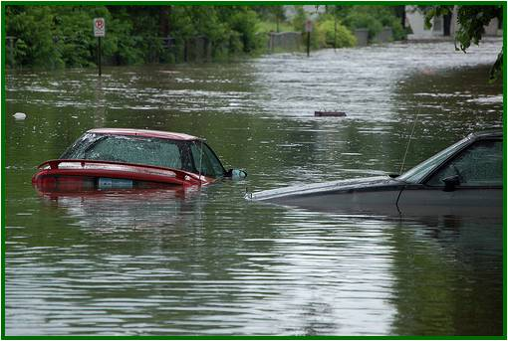
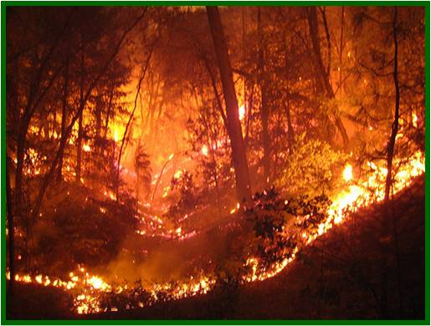
Global Warming
Oftener and more powerfull:
aridity and forest fires, floods and storms
Damage Hurricane Sandy: 100 Billion US $

Slide 7
Oil, Gas and Coal are the Main Causes of Damage to the Climate
Burning of oil, gas, coal emits ~ 80% of all greenhouse gases worldwide
Real climate protection is only possible by ending the use of oil, gas, coal; this means using exclusively renewable energy and renewable chemistry
Energy saving is very helpful; but energy saving alone will not solve the climate problems

Slide 8
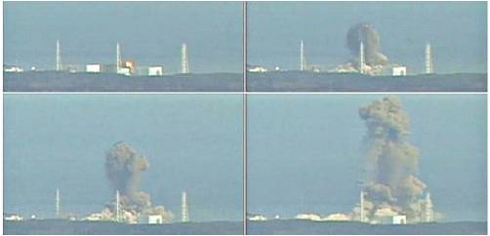
Fukushima March 2011
Until 2012 the costs of the reactor disaster amount 100 bn. €
Quelle Bild: BFlickr/Oldmaison
Quelle: Tepco, 7.11.2012

Slide 9
Nuclear Renaissance? Only very few new started. All are overbudget and late
Olkiluoto (Finland):
build start 2005; forecast cost 3 bn. €, 4 years; 2012: >6 years late, >100% overbudget
Flamanville (France):
start 2007; forecast cost 3.3 bn. €, 5 years; 2012: >2016 ready (9 years), >costs 8.5 bn. €

Slide 10
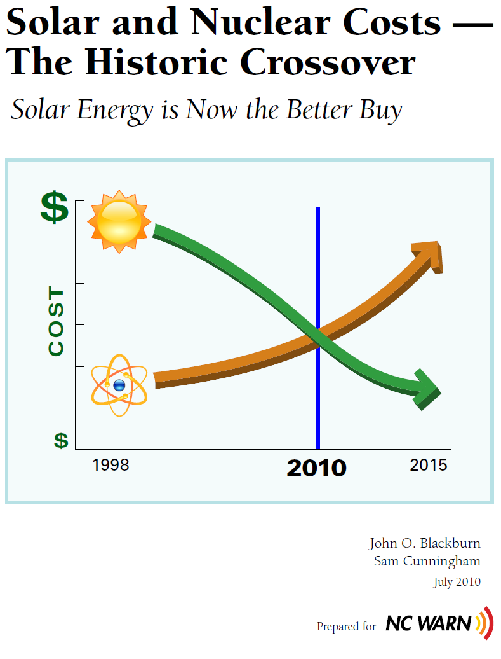
Solar and Nuclear Costs – The Historic Crossover
Solar Energy is Now the Better Buy
Source: John O. Blackburn, Sam Cunningham, 2010; NC Warn

Slide 11
Annual Additions of Nuclear and Wind Capacities in Megawatts
Source: Rechsteiner, IAEA

Slide 12
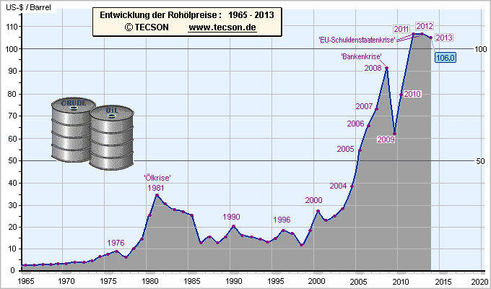
Development of Crude Oil Prices 1960-2012
EURO Crisis
Financial crisis
Oil crisis
Source: Tecson

Slide 13
Price of Natural Gas in Europe
Source: BMWi, 2013

Slide 14
The Euro Crisis is also an Oil Crisis
EU-27 in 2011:
Foreign Trade Deficit:
-196,20 Bn. €
Imports of Energy Resources:
488,476 Bn. €
Sources: statista, 2013; eurostat, 2013

Slide 15
Development of Feed-in Tariffs for photovoltaic roof systems above 1 MW
in €Cent
Quellen: EEG 2004, EEG 2009, EEG 2013

Slide 16
Unsubsidised Renewables now cheaper than coal and gas power
Bloomberg Study 2013:
New build Windfarm: 80 AUD/MWh
New buildt coal power: 143 AUD/MWh
New buildt gas power: 116 AUD/MWh
Renewables are now cheaper, even in a country like Australia with very cheap coal ressources
Source: http://www.crikey.com.au/topic/renewable-energy/

Slide 17
Solar PV: existing global capacity 1995-2013 in GW
in 2011: 30,2 GW of new photovoltaic plants were installed
in 2012: 29,9 GW were installed
The worldwide capicity has now reached 136,7 GW.
Source: REN21, EPIA

Slide 18
China annual power grid capacity additions (GW)

Slide 19
The world trend is clear: Renewable will fast increase; fossil and nuclear will decrease
Energy consumer countries will go out of fossil fuels because of rising prices and climate protection
Energy producer countries must now this trend
When they are too late to go to renewables they will face great economic desaters in the coming decades

Slide 20
A Path to 100% sustainable energy by 2030
‘Wind, water and solar technologies can provide
100 percent of the world’s energy, eliminating all
fossil fuels.‘
(Mark Z. Jacobson & Mark A. Delucchi)
Source: Standford / Duke University

Slide 21
Share of renewables in the gross electricity consumption in Germany
Source: BMU, BEE, bdew

Slide 22
German electricity export: after phasing out 8 nuclear reactors record export in 2013
in bn. kWh
Quelle: statista,de 2012; AGEB, 2013

Slide 23
My advice for Malaysia
Fast development of renewable sector in Malysia
Wind, Solar, Geothermal, Hydro, Waves
Bioenergy also for export:
Biofuels from sustainable farms (no Rainwood cutting)
Biocoal from agriculture and municipal waste
Otherwise Malaysia will loose the main business of oil without any compensation

Slide 24
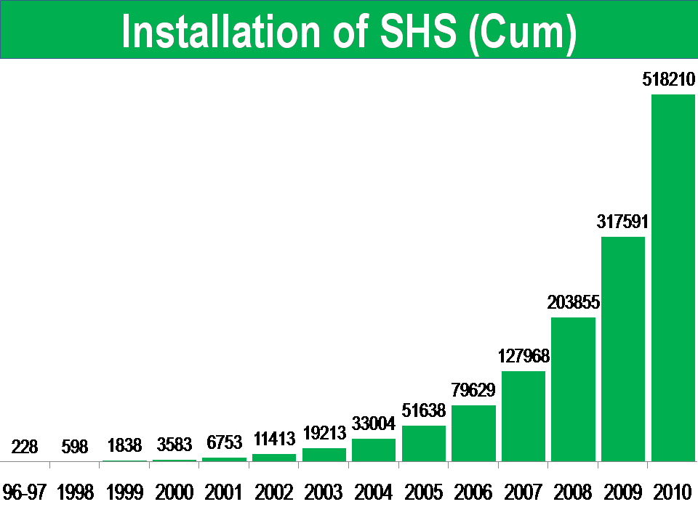
Amount of the installed solar home systems by the Grameen Bank in Bangladesh
Solarpower helps to reduce Poverty
Source: www.gshakti.org

Slide 25
Asia-Pacific Supergrid
Study ANU, Canberra, Prof Dr. Andrew Blaker:
pv plants, hydro-pump-storage power
in Australia plus supergrid
will produce solarpower
by 8 $Cent/kWh
for Australia and Southeast Asia

Slide 26
3 MW Solar power plant Belectric
Quelle: http://www.belectric.com

Slide 27
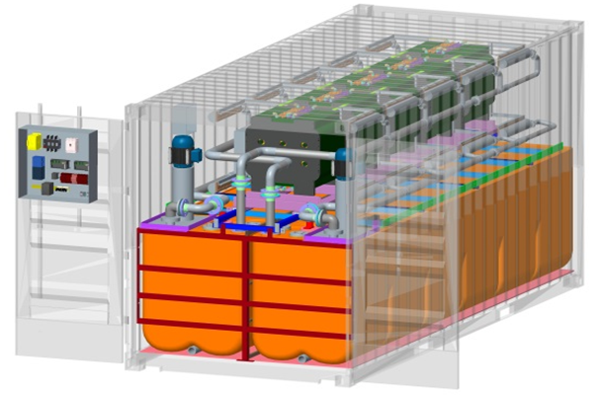
Z20 – Energy-/Electrical Power Storage from BlueSky Energy
Standard Container
(6,1 x 2,4 x 2,4 m)
(20 x 8 x 8 ft.)
Technology: Zinc-Iron Redox-Flow-Battery
Application: PV-systems and wind parks
Green Technology: contaminant-free, non-toxic, non- flammable, non-explosive
Sustainability: Raw material worldwide „unlimited" and inexpensive available
Scalability: One Battery (container) contains 48 – 80 kW power → 120 – 160 kWh energy; scalable up to multiple MWh
Cost effectiveness: most cost-effective and safest technology of all large energy storage systems. Cost per kWh: currently 0,10 €/kWh; with decreasing tendency. ROI approx. 7 years
Life time: 20+ year life at 7000 cycles
Pump
3 – 5 Battery Stacks
Tanks for Electrolytes

Slide 28
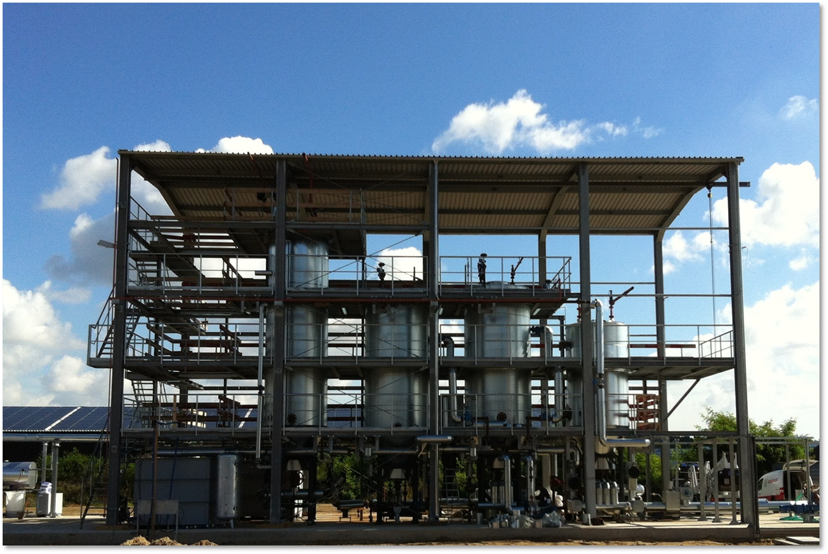
Hydrothermal Carbonisation (HTC)
Process:
Input: Plants, Agriculture and Municipal Waste;
Output: Biocoal;
Usage of biocoal:
Fuel: 8 €/MWh (Mineral Coal 22 €/MWh)
Chemical base (oil substitute)
Fertiliser (carbon binding in soil)
Source: Ava-Co2; Antora; EU Projekt Bioboost

Slide 29
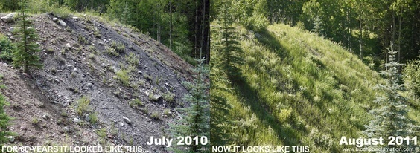
With biochar rapid greening for eroded and degraded areas
July 2010
August 2011
For 60 years it looked like this
Now it looks like this
Slag heap of a US coal mine
Source: Aspen Global Change Institute

Slide 30
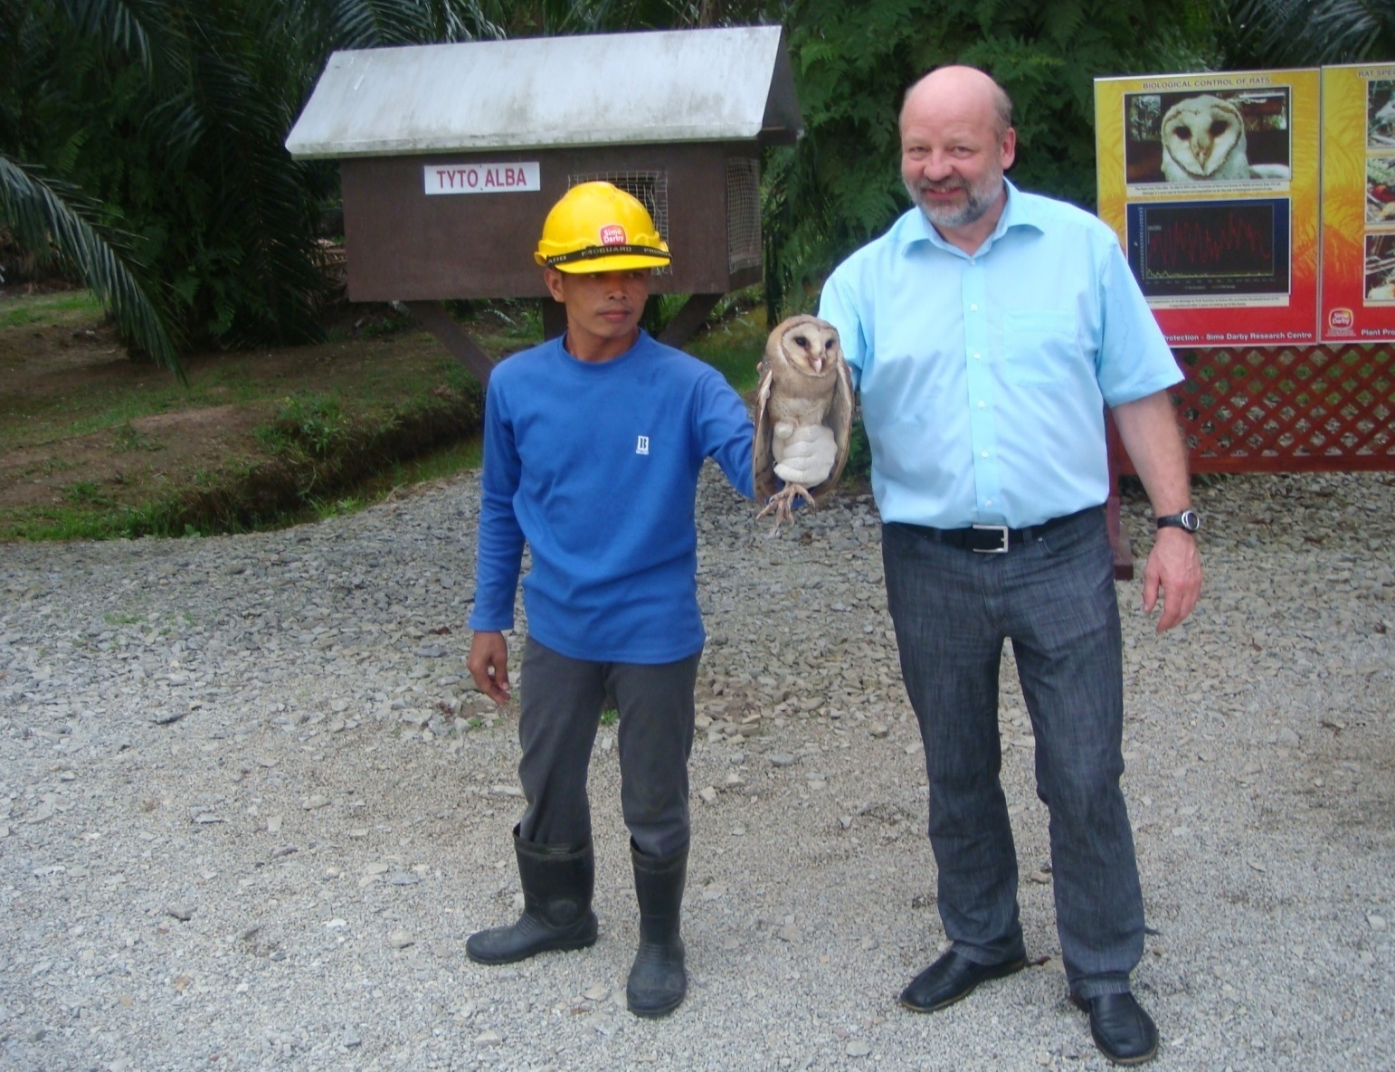
Ecological Oil Palm Plantage, Sime Darby, Malaysia
Source: Hans-Josef Fell

Slide 31
New Book about Global Cooling
published in summer 2012.
paperback edition for 19 €.
www.globalcooling-climateprotection.net

Slide 32
Thank You Very Much for Your Attention!
www.hans-josef-fell.de

